Slide 1
R. Paige ES Sdmc Meeting
January 19, 2022

Slide 2
Extra-curricular activities

Slide 3
Girls on the Run
Fifteen of our 3rd – 5th grade girls will be chosen to participate in Girls on the Run, a program that will teach them how to use their social, emotional, physical and behavioral skills to successfully navigate life experiences.

Slide 4
Intervention Support

Slide 5
ieducate Tutors
CRM Name | First Name | Last Name | Email | Phone Number | Assigned Teacher/Coordinator | Subject/Grade Level | Background Check Status | Additional Languages Spoken | Subjects NOT Willing to Teach
Emily Martinez | Emily | Martinez | emymtz2803@gmail.com | 8327312432 | Janie Solis | 4th Grade Math and Reading | Cleared | Spanish | Math
Gabriela L Hernandez | Gabriela | Hernandez | gabrielahern83@gmail.com | 832-873-1628 | Janie Solis | 4th Grade Math and Reading | Awaiting Clearance | Spanish | Math
Kennedy R Nelms | Kennedy | Nelms | kcnelms.biz@gmail.com | 8326095165 | Lily Wheeler | 3rd Grade Reading | Awaiting Clearance | None | Willing to teach all subjects
Gerardo Rubio | Gerardo | Rubio | rubiogerardo100@gmail.com | 2812481385 | Janie Solis | 3rd Grade Math and Reading | Awaiting Clearance | Spanish | Reading & writing
Jayla M Okay | Jayla | Okay | jaylaokay17@gmail.com | 8325679677 | Janie Solis | 3rd Grade Math and Reading | Awaiting Clearance | None | Science

Slide 6
Camp Spark
March 14-16, 2022
Monday - Wednesday

Slide 7
Safety

Slide 8
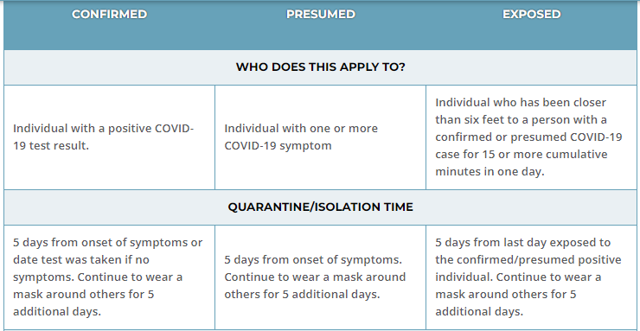
COVID 19 PROTOCOL

Slide 9
COVID 19 PROTOCOL

Slide 10
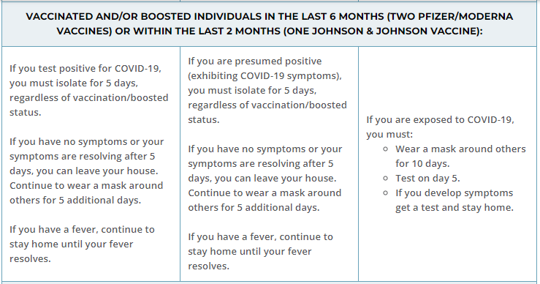
COVID 19 PROTOCOL

Slide 11
COVID 19 PROTOCOL

Slide 12
